Slide 1
Predicting defaulting on credit card applications
Yingjia Zhai
Notes:
My final project is about Neo4j and graph databases.

Slide 2
Purpose
This project aimed at analyzing customers default payments in Taiwan and compares the predictive accuracy of default by using different classification methods, and pick the best one to make predictions.

Slide 3
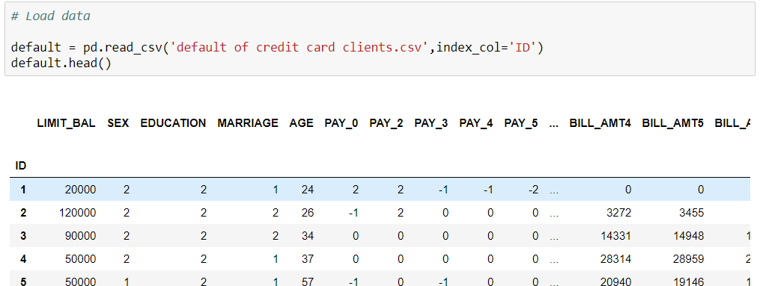
Data Set
LIMIT_BAL | SEX | EDUCATION | MARRIAGE | AGE
PAY_0 | PAY_2 | PAY_3 | PAY_4 | PAY_5 | PAY_6
BILL_AMT1 | BILL_AMT2 | BILL_AMT3 | BILL_AMT4 | BILL_AMT5 | BILL_AMT6
PAY_AMT1 | PAY_AMT2 | PAY_AMT3 | PAY_AMT4 | PAY_AMT5 | PAY_AMT6
default payment next month

Slide 4
Phases
Load the credit card default dataset
Data Preparation
Build models- Logistic Regression, Classification Trees, and Naive Bayes
Model Evaluation and comparison
Make predictions

Slide 5
Modeling
Will compare the predictive power of three classification algorithms in scikit-learn
1. Logistic regression
2. Classification Trees
3. Naive Bayes Classifier

Slide 6
Techniques
one-hot encoding to encode the information in categorical features.
For example: Education
1 = graduate school; 2 = university; 3 = high school; 4 = others
After Encode:
Graduate: 1 0 0
University: 0 1 0
High school: 0 0 1
Others: 0 0 0

Slide 7
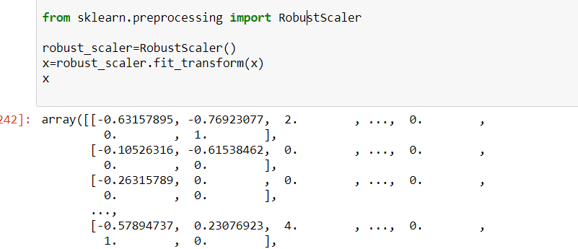
Scaling variables by using Robust scaler
All the variables have very different scales.
For example: Amount and age

Slide 8
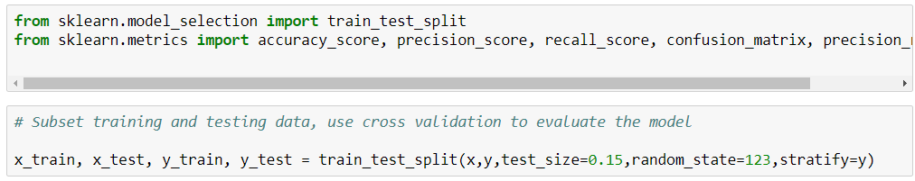
Prepare training and testing dataset
**From sklearn.model_selecting import train_test_spilt()
Stratify = Y is assigned in proportion to Y
make the ratio of all data in the trainset and the testset the same as the original data set.

Slide 9
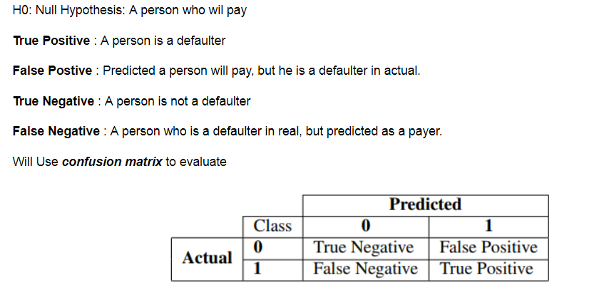
Hypothesis
False Negative is the biggest concern

Slide 10
Evaluation
Accuracy - Accuracy is the ratio of correctly predicted observation to the total observations. Accuracy = TP+TN/TP+FP+FN+TN
Precision - Precision is the ratio of correctly predicted positive observations to the total predicted positive observations. Precision = TP/(TP+FP)
Recall (Sensitivity) - Recall is the ratio of correctly predicted positive observations to the all observations in actual class – yes Recall = TP/(TP+FN)
For this case:
Accuracy: the ratio of correctly predicted customers as defaulters
Precision: For all customers that labelled as defaulters, how many actually are correct.
Recall: of all customers that truly default, how many did we correctly predict.

Slide 11
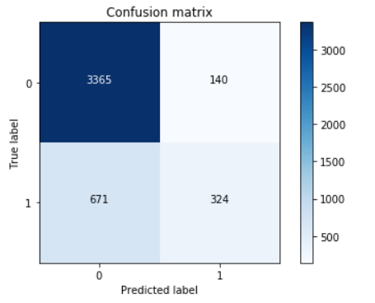
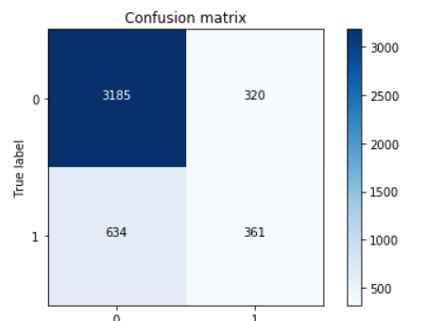
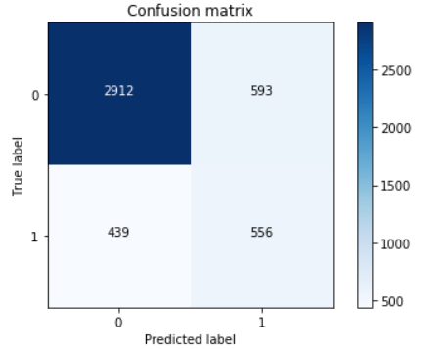
Models
Logistic Regression Model
Classification Trees
Naive Bayes Classifier

Slide 12
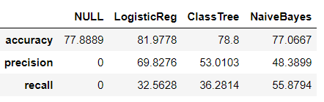
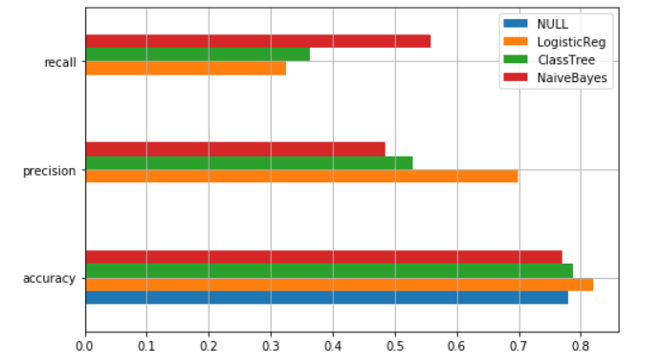
Comparison

Slide 13
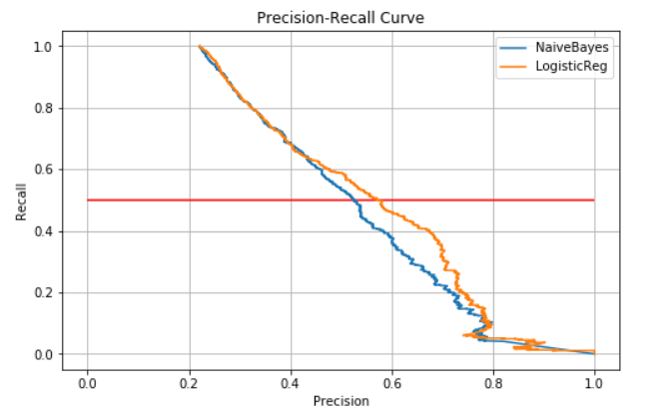
Comparison between Logistic and Naive
LogisticReg has better precision score when recall same

Slide 14
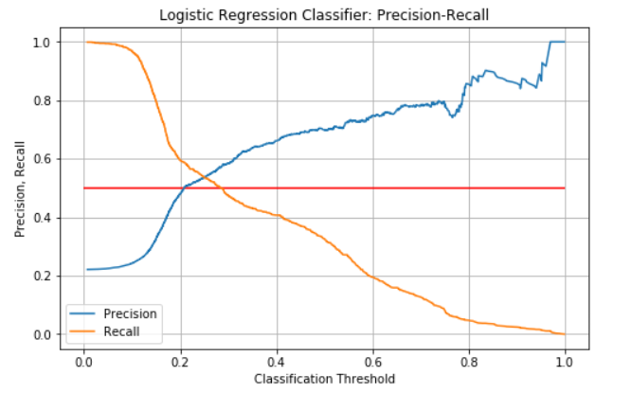

Relationship
When threshold is about 0.2, Logistic Regression model has better recall ratio

Slide 15
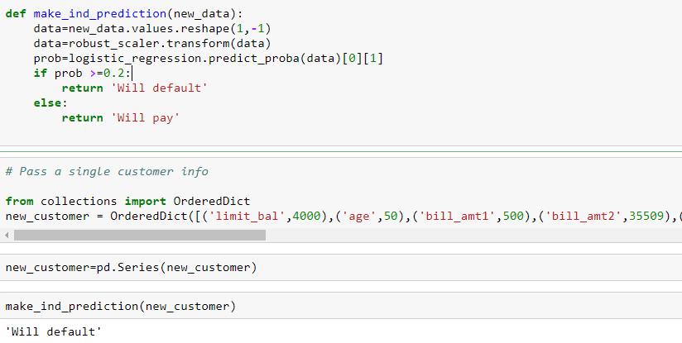
Making individual predictions
When threshold is about 0.2

Slide 16
Questions?

